Slide 1
Section 2.6 Mortgages

Slide 2
Annuities and Mortgages
Buying a car or house is a financial decision that most people will encounter in their life time. In this section, we will look at how banks and financial companies compute the loan payment that a costumer’s will pay when they finance a home or car.

Slide 3
Mortgage Payments
Loan Payment Formula:

Slide 4
Example 1
What would your monthly house payment be on a $140,000 house if you finance the house for 30 years at an interest rate of 6%?

Slide 5
Solution to Example 1
Use the loan payment formula.

Slide 6

Solution to Example 1
How much interest did we pay?
$$360\left(\$839.37\right)=\$302,173.20$$
$$Interest paid=\$302,173.20−\$140,000=\$162,173.20$$

Slide 7
Example 2
The available interest rate on a $200,000 house is 6% per year. Compare the monthly payments for a 30 year loan and 15 year loan, and then determine which loan the 30 year or 15 year pays the least amount of interest.

Slide 8
Solution to Example 2
30-year loan
15-year loan

Slide 9
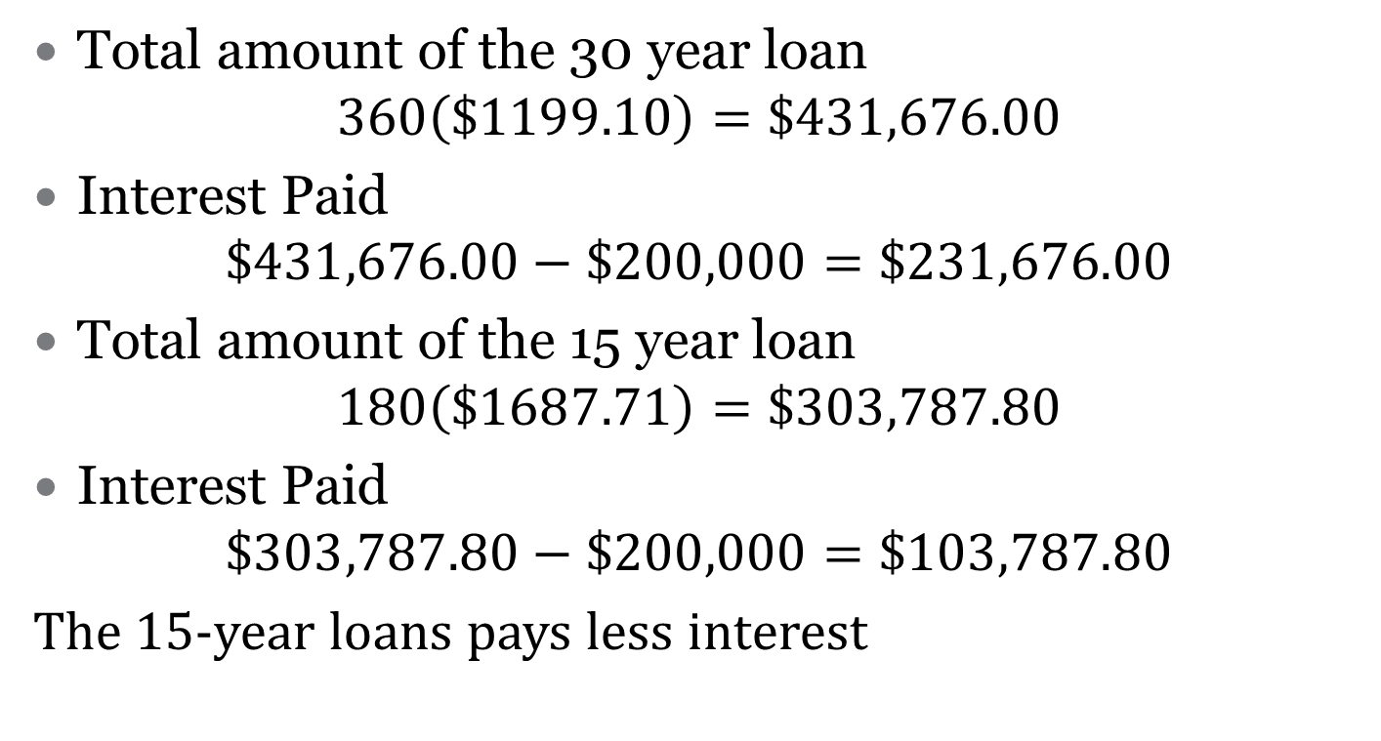
Solution to Example 2
Total amount of the 30 year loan
$$360\left(\$1199.10\right)=\$431,676.00$$
Interest Paid
$$\$431,676.00−\$200,000=\$231,676.00$$
Total amount of the 15 year loan
$$180\left(\$1687.71\right)=\$303,787.80$$
Interest Paid
$$\$303,787.80−\$200,000=\$103,787.80$$
The 15-year loans pays less interest

Slide 10
Summary
30 years loan versus | 15 years loan
1. Lower monthly payment | 1. Higher monthly payment
2. More to pay over life of loan | 2. Less to pay over life of loan
3. More interest to pay | 3. Less interest to pay
4. Initially, more monthly payment goes towards off interest | 4. Initially, more monthly payment goes towards principal
5. Takes a longer time to pay off the loan | 5. Pays off the loan faster

